Slide 1
Project 5 - Crypto Platforms
Cynthia Rittenbach, Daniel Pol, Frank Santos, Jonathan Metry

Slide 2
Prompt
Your team is involved in designing a new cryptocurrency for a sovereign client. You have been asked to evaluate crypto platforms for the basis of your currency. As a substitute fiat currency, the government is mindful of certain processes and regulations that should be supported and continue to operate flawlessly with the
new crypto currency regime as well. These include Anti-Money Laundering (AML), Know Your Customer (KYC), and Fraud detection. What does your team think and would suggest as your team’s platform of choice to your client?

Slide 3
Intro
AML(Anti-Money Laundering) - A collection of crime prevention concepts to monitor and prevent financial crime in cryptocurrency, combating risks such as trading illicit funds, tax evasion, and terrorist financing.
KYC(Know Your Customer) - A process used by financial institutions to verify the identity of their customers, know their risk and financial profiles. This allows for better understanding of the risk of illegal activities.
Fraud Detection - The method of identifying and preventing fraud, such as identity theft, payment fraud, etc., in order to safeguard customer assets.

Slide 4
Intro - Extended
Platform business model - A business structure that creates a digital platform that facilitates interactions and transactions between different groups of users, focusing on generating revenue
Cybersecurity policy - The set of rules and procedures designed to protect the integrity of a cryptocurrency platform, protecting the platform from cybercrime such as hacking, phishing, fraud, etc.
Sovereign Coin - A cryptocurrency that is based on and controlled by an authority, most often a government. The government has full control over supply, distribution, and the usage.

Slide 5


AML(Anti-Money Laundering)
In 2022, fined $30 million by NY Department of Financial Services for failing to comply with AML regulations
under staffed
Relying on manual translation monitoring system (inadequate for company size, customer profiles, transaction volumes)
KYC(Know Your Customer)
Customers are required to submit government-issued IDs and personal information to verify identities when creating an account
Prevents anonymous accounts, reducing tax evasion and money laundering
For a sovereign currency, this could deter citizens who prioritize financial privacy and anonymity
Fraud Detection
Built its own real time fraud detection system which analyzes time-series data to detect suspicious transactions
The systems reliance on AI algorithms can potentially conflict with sovereign cryptos need for transparency in public financial systems

Slide 6
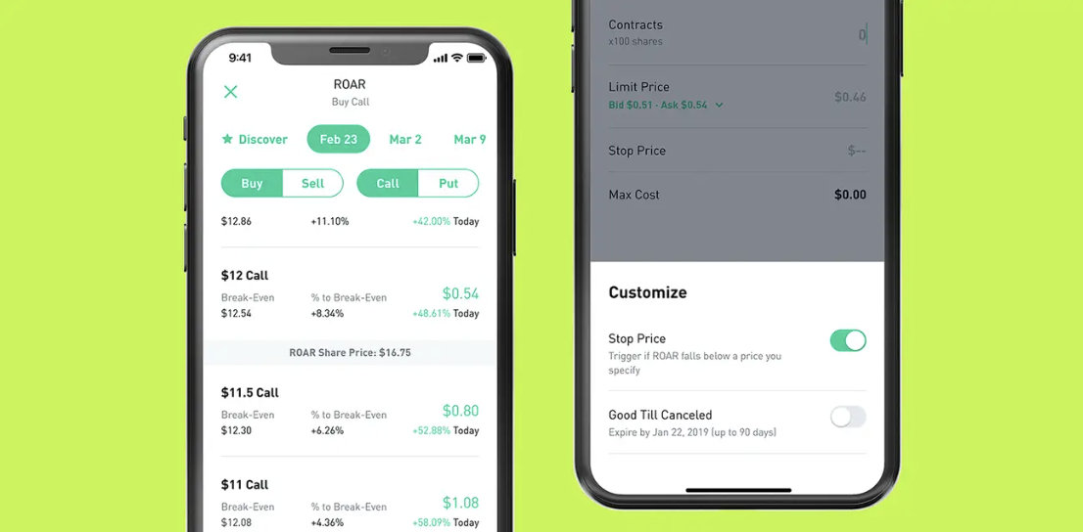
Performance
In March 2020, Robinhood experienced a 24-hour outage during a period of high market volatility caused by the pandemic. Investors were unable to access the company’s help center, website, or mobile application.
This event exposed weaknesses in Robinhood’s infrastructure
Sovereign cryptocurrencies require systems capable of handling sudden surges in volatility without service interruptions
Privacy
Robinhood has a policy in which it discloses user information to other companies owned by Robinhood, such as name, address, telephone number, or social security.
This opposes the privacy and autonomy ideals of a sovereign crypto.

Slide 7



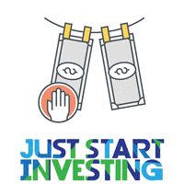
AML (Anti-Money Laundering)
- Monitoring transaction patterns for suspicious activity.
- Reporting irregular transactions to regulatory authorities.
- Leveraging blockchain analytics to trace fund origins.
Why It Matters for Sovereign Cryptocurrency
- Ensures legitimacy of financial transactions.
- Deters criminal organizations from exploiting the currency.
- Aligns with international frameworks like FATF guidelines.
KYC (Know your Customer)
- Identity verification using government-issued IDs.
- Address verification with utility bills or other documentation.
- Enhanced Due Diligence (EDD) for high-risk accounts.
Why It Matters for Sovereign Cryptocurrency
- Protects the system from misuse by anonymous actors.
- Builds public trust in the new currency.
- Complies with international regulatory standards.
Notes:
Definition: AML policies are designed to detect and prevent money laundering and terrorist financing.
Bottom Line: AML ensures the integrity of the financial system by identifying and eliminating threats.

Slide 8

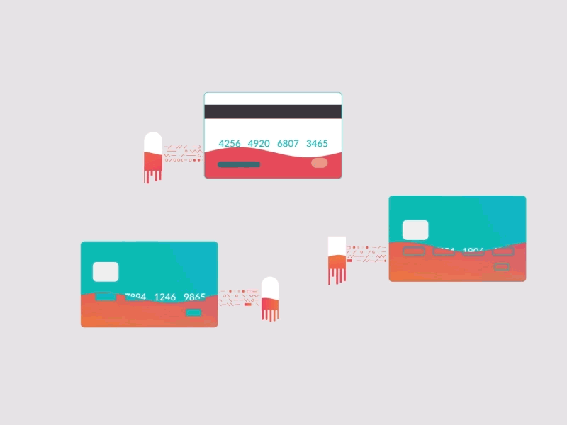
Coinbase
Fraud Detection
- AI and machine learning algorithms for anomaly detection.
- Real-time monitoring of transactions and user behavior.
- Collaboration with law enforcement and peer platforms to combat fraud.
Why It Matters for Sovereign Cryptocurrency
Protects users from scams and fraudsters.
Reinforces public confidence in adopting the new system.
Ensures seamless and secure financial operations.
Business Model
Cryptocurrency exchange and financial services provider for retail and institutional clients.
Revenue streams: transaction fees, subscriptions, custody services, and blockchain tools.
Focused on regulatory compliance, security, and user-friendly design.
Offers features like staking, NFTs, and developer tools to expand into emerging markets.
Positioned as a trusted, secure gateway for digital assets.
Notes:
Definition: Fraud detection involves identifying and preventing malicious activities, such as account takeovers and fake identities.\
Bottom Line:
Fraud detection is critical to maintaining user confidence and system security.

Slide 9
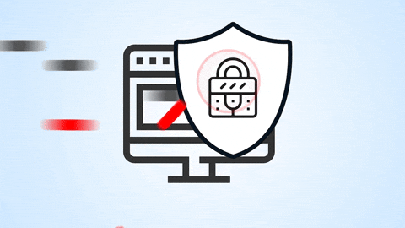
CyberSecurity Policies
Majority of funds stored offline in secure cold wallets.
Mandatory 2FA and advanced account protection features.
End-to-end encryption for sensitive data (TLS, AES-256).
Regular penetration testing and active bug bounty program.
AI-driven fraud detection and 24/7 threat monitoring.
Compliance with global standards like GDPR, CCPA, and AML/KYC
Rapid incident response and employee security training.
Notes:
Definition: KYC ensures that customer identities are verified to prevent fraud, money laundering, and other illicit activities.
Bottom Line:
KYC is the first line of defense in ensuring transparency and trust in the cryptocurrency ecosystem.

Slide 10
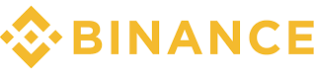
AML(Anti-Money Laundering)
Has faced several AML allegations
Most notably, plead guilty to one of them, with over 4 billion dollars in federal charges (2023)
Ceo sentenced to 4 months in prison
Since then however, due to many federal requirements related to the conviction:
External independent compliance monitor
Treasury has unconditional access to books and records for the next 5 years
Complete sanction compliance
Also, forced to exit the USA, so after these sanctions end, uncertain where the company may go
KYC(Know Your Customer)
Shady past pre-sanctions
Open accounts without identification, which has led to countless malicious users
Terrorists
Ransomware attackers
Post suit requirements began in (2021)
Government issued ID, Proof of home address
Can create account without, but no access to trade, buying, selling
Takes about 20 days to verify
Customers are internally re-verified and actions are monitored on a regular basis

Slide 11
Fraud Detection -
Similar trend, very shady before lawsuit
Now has AI and ML tools that automatically can detect fraud and flag problems probabilistically
Tools trained to differentiate between fraud and genuine interactions, and paired with real people, provide a strong line of defense.
Regularly freezes suspicious assets before malicious actors can use
Claim of 2.5billion in prevented losses in the first seven months of 2024
Business Model -
Trading fees are the main source of income
Steep 0.5% on buy/sell crypto
0.1% spot trading fee
These fees are very important to consider in terms of deciding which platform to use, especially because our purpose will be very transaction heavy.
Other charges:
Withdrawal fees`
Cloud services
Exchange rates

Slide 12
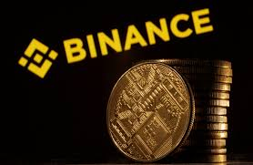
Cybersecurity Policy:
Heavy emphasis on 2FA and alternative authorization methods
Real time monitoring of all transactions
Access control:
Can limit/block certain IPS
Secure asset fund
1 billion dollars saved for customer reimbursement
Threshold Security Schemes
Require multiple parties to authorize a transaction

Slide 13
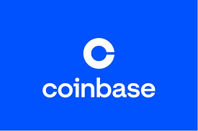
Conclusion
Based on these metrics and history:
Coinbase provides:
Sufficient protection against fraud/AML
A use friendly experience
Commendable security track record
A clean history compared to the other 2 options
Normalized fees, not above industry standard
In conclusion, among the big 3, Coinbase provides a reliable platform for the creation of our new sovereign coin.

Slide 14
Sources
https://www.elliptic.co/anti-money-laundering-aml-in-cryptocurrency
https://www.investopedia.com/terms/k/knowyourclient.asp
https://sdlccorp.com/post/cryptocurrency-exchange-platform-business-model/
https://techdetector.de/stories/sovereign-cryptocurrency
https://www.binance.com/en/blog/tech/binance-p2ps-invisible-guardians-using-computer-vision-to-detect-fraud-7256282002014933080
https://www.justice.gov/opa/pr/binance-and-ceo-plead-guilty-federal-charges-4b-resolution
https://academy.binance.com/en/glossary/know-your-customer

Slide 15
Sources
Understand Binance Business Model: Find Out How Does Binance Make Money?
Coinbase. "How Does Coinbase Comply with Anti-Money Laundering (AML) Laws?" Coinbase Help Center. Coinbase, https://help.coinbase.com/. Accessed 18 Nov. 2024.
Coinbase. "Coinbase: About Us." Coinbase. Coinbase, https://www.coinbase.com/. Accessed 18 Nov. 2024.
Coinbase. "Security at Coinbase." Coinbase. Coinbase, https://www.coinbase.com/security. Accessed 18 Nov. 2024.
https://www.moneylaunderingnews.com/2022/08/crypto-compliance-matters-nydfs-fines-robinhood-30m-for-alleged-aml-cybersecurity-and-consumer-protection-violations/
https://markets.businessinsider.com/news/stocks/robinhood-sec-finra-investigation-march-trading-service-outage-stock-brokerage-2020-8-1029548651
https://robinhood.com/us/en/support/articles/privacy-policy/

